Slide 1

Computer Architecture
Course Code: CSE360
Lecture 9
Instruction Sets:
Characteristics and Functions

Slide 2
What is an Instruction Set?
The complete collection of instructions that are understood by a CPU
Machine Code
Usually represented by assembly codes
Notes:
2

Slide 3
Elements of an Instruction
Operation code (Op code)
  Specifies the operation to be performed (Do this)
Source Operand reference
  Specifies the input locations for the operations (To this)
Result Operand reference
  The operation may produce output or result (Put the answer here)
Next Instruction Reference
  This tells the processor where to fetch the next instruction after the execution of this instruction is complete
Notes:
3

Slide 4
Where have all the Operands Gone?
Source and result operands can be in one of three areas:
Main memory (or virtual memory or cache) – As with next instruction references, main or virtual memory address must be supplied
CPU register- A processor may contain one or more registers that may be referenced by machine instructions
I/O device- The instruction must specify the I/O module and device for the operation.
Notes:
4

Slide 5
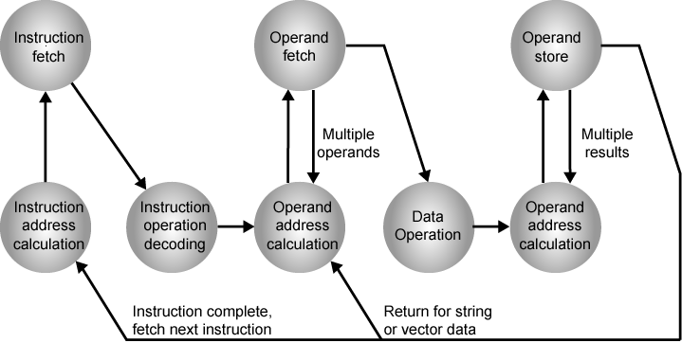
Instruction Cycle State Diagram
- Opcodes specify arithmetic and logic operation, movement of data between two registers, register and memory, or two memory locations (ADD, SUB, MPY, DIV, LOAD, STOR)
- Operand references specify a register or memory location of operand data

Slide 6
Instruction Cycle State
Instruction address calculation: Determine the address of the next instruction to be executed.
Instruction fetch: Read instruction from its memory location into the processor.
Instruction operation decoding: Analyze instruction to determine type of operation to be performed and operand to be used
Operand address calculation: If the operation involves reference to an operand in memory or via I/O, then determine the address of the operand.
Operand fetch: Fetch the operand from memory or read it in from I/O.
Data operation: Performs the operation indicated in the instruction
Data store: Write the result into memory or out to I/O.

Slide 7
Instruction Representation
In machine code each instruction has a unique bit pattern
Opcodes indicate the following operation:
  e.g. ADD, SUB, MPY, DIV, LOAD, STOR
Operands can also be represented in this way
  ADD R,Y
  (Add the value contained in data location Y with the content of register R; in this example, Y refers to the address of a location in memory and R refers to a particular register).
  Note that: The operation is performed on the contents of a location; not on its address
Notes:
5

Slide 8
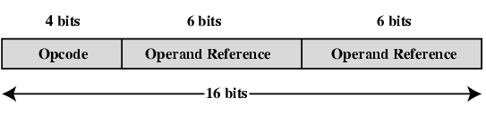
Simple Instruction Format

Slide 9
Instruction Types
Data processing: Arithmetic and logical operation
Data storage (main memory): Memory instructions
Data movement (I/O): I/O instructions
Program flow control: Test the value and status of a computation and branch instructions
Notes:
6

Slide 10
Number of Addresses (a)
3 addresses
  Operand 1, Operand 2, Result
  a = b + c;
  May be a forth - next instruction (usually implicit)
  Not common
  Needs very long words to hold everything
Notes:
7

Slide 11
Number of Addresses (b)
2 addresses
  One address doubles as operand and result
  a = a + b
  Reduces length of instruction
  Requires some extra work
    Temporary storage to hold some results
Notes:
8

Slide 12
Number of Addresses (c)
1 address
  Implicit second address
  Usually a register (accumulator)
  Common on early machines
Notes:
9

Slide 13
Number of Addresses (d)
0 (zero) addresses
  All addresses implicit
  Uses a stack
  e.g. push a
  push b
  add
  pop c
  c = a + b
Notes:
10

Slide 14
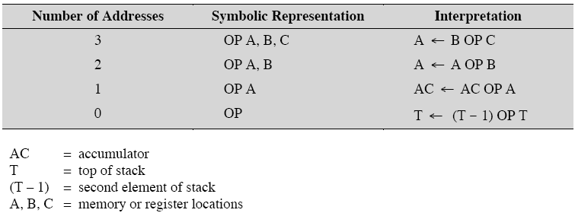
Number of Addresses - summary
Notes:
10

Slide 15
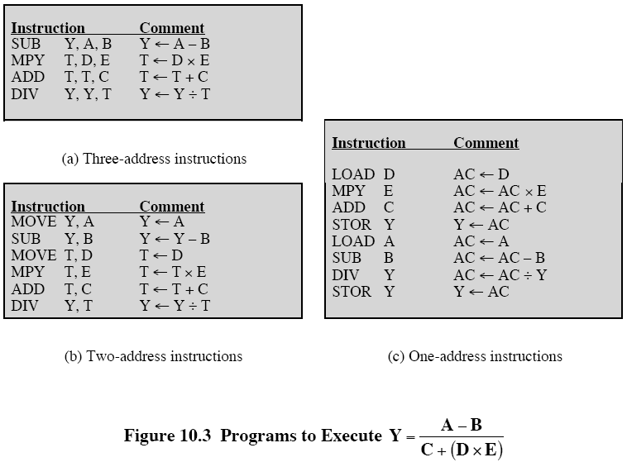
Number of Addresses - Execution
Notes:
10

Slide 16
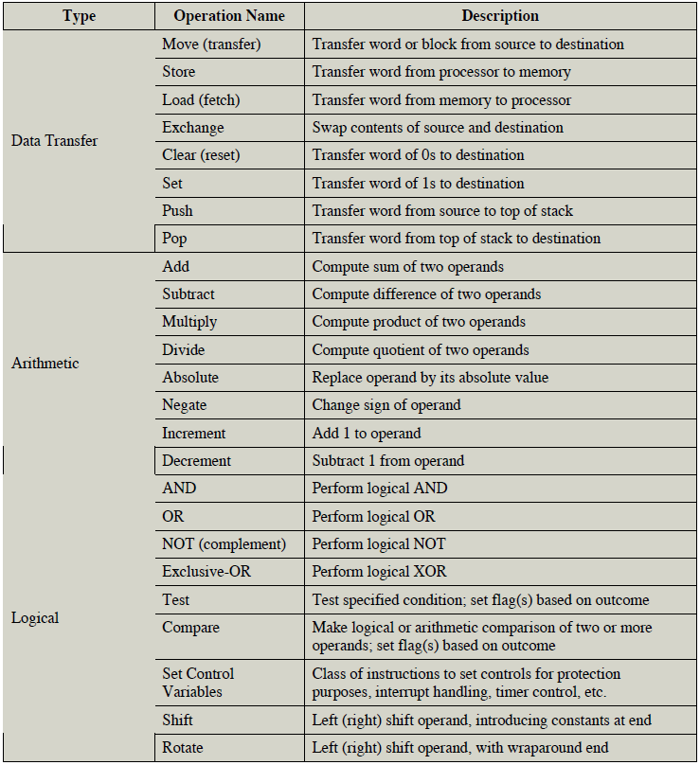
Common Instruction Set Operations
Notes:
19

Slide 17
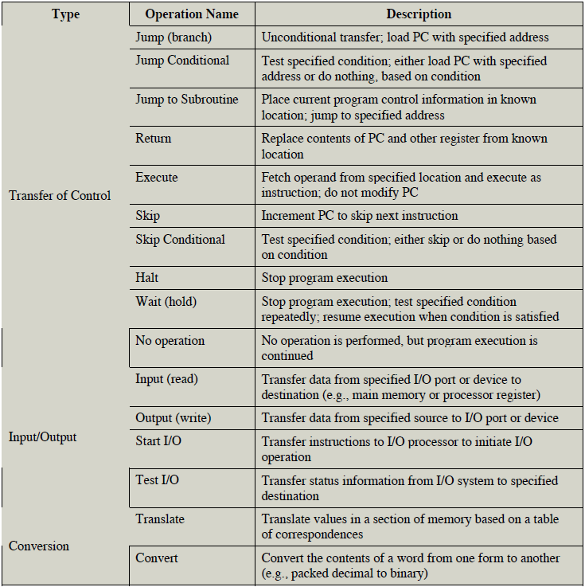
Common Instruction Set Operations
Notes:
19

Slide 18
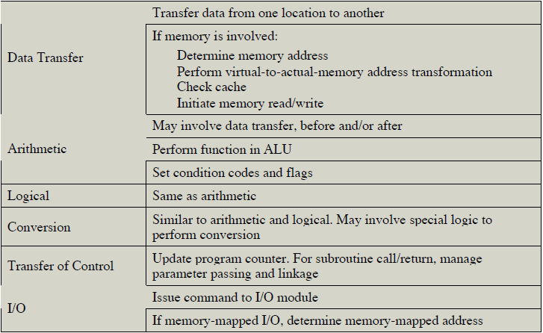
Common Instruction Set Operations
Notes:
19

Slide 19
Arithmetic
Add, Subtract, Multiply, Divide
Signed Integer
Floating point ?
May include
  Increment (a++)
  Decrement (a--)
  Negate (-a)
Notes:
20

Slide 20
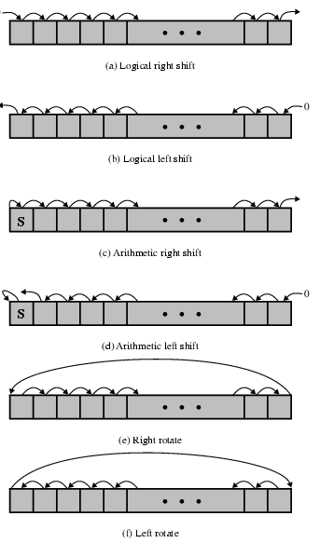
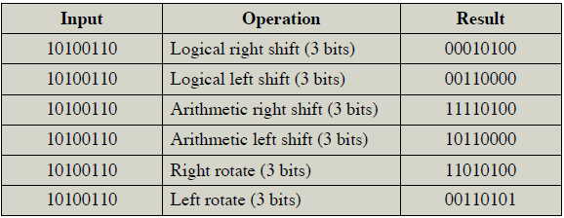
Shift and Rotate Operations

Slide 21
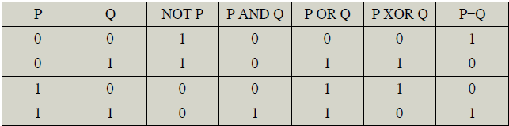
Logical
Bitwise operations
AND, OR, NOT
Notes:
21

Slide 22
Conversion
E.g. Binary to Decimal
Notes:
22

Slide 23
Transfer of Control
Branch/Jump instruction
Conditional Branch
  BRP X (Branch to location X if result is positive)
  BRN X (Branch to location X if result is Negative)
  BRZ X (Branch to location X if result is Zero)
  BRO X (Branch to location X if result is Overflow)
  BRE R1, R2,X (Branch to X if contents of R1=contents of R2)
  BRP X (Branch to location X if result is positive)
Unconditional branch
Notes:
25

Slide 24
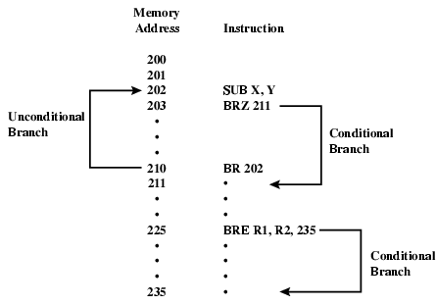
Branch Instruction

Slide 25
Transfer of Control
Skip
  ISZ - increment and skip if zero (like continue in C++)
  R1 is set with negative number. R1 is incremented as the number of iteration performed. If it is not zero program branches back to zero, otherwise branch is skipped and program continues to next instruction after end of loop.
301
.
.
ISZ R1
BR 301
Subroutine call
  c.f. interrupt call
Notes:
25

Slide 26
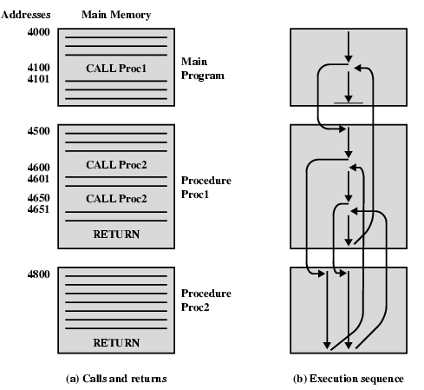
Nested Procedure Calls

Slide 27
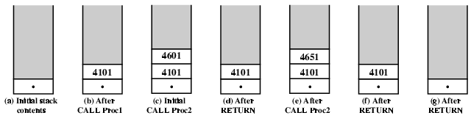
Use of Stack

Slide 28
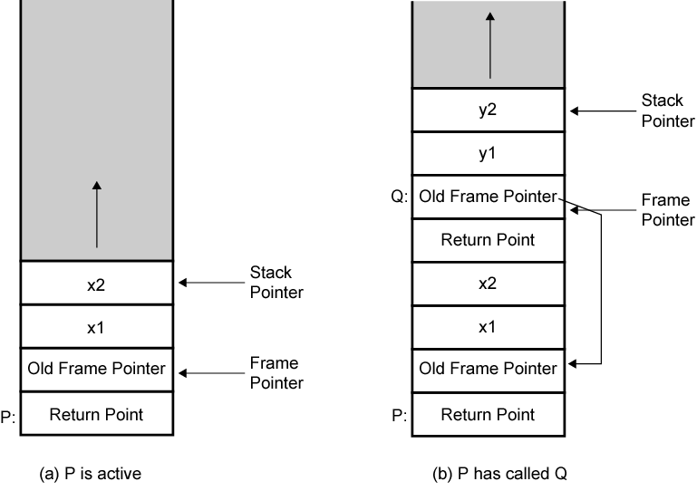
Stack Frame Growth Using Sample Procedures P and Q
When the processor executes a call, it not only stacks the return address, it stacks the parameters to be passed to the called address. The called procedure can access the parameters from stack. Upon return, return parameters can also be placed on the stack. The entire set is called stack frame.

Slide 29
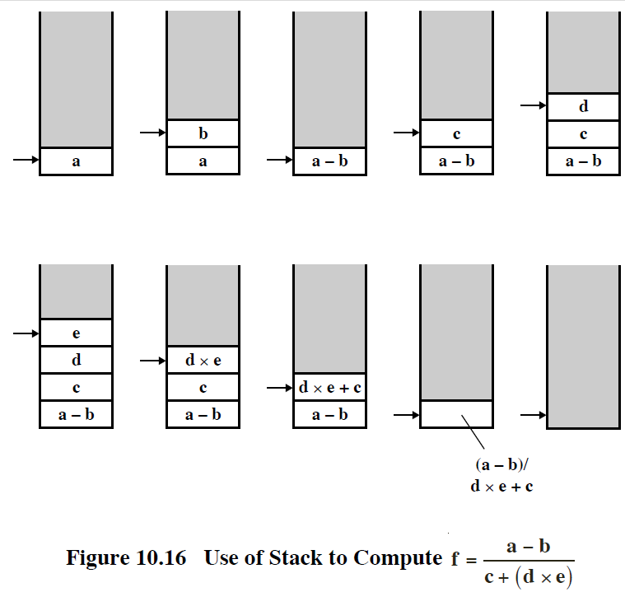
Use of Stack for computation

Slide 30
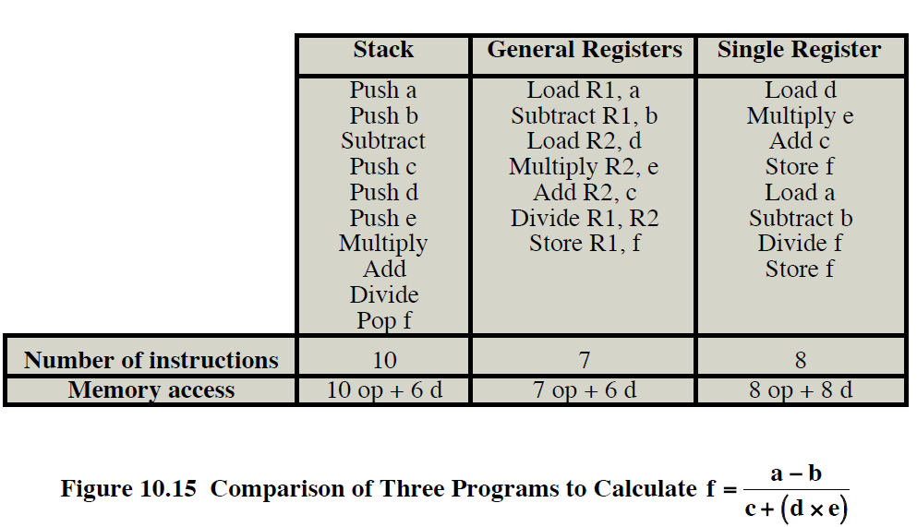
Comparison of three programs

Slide 31
Expression Evaluation
Mathematical formulas are expressed is known as infix notation
a+(b x c) will yield different result than (a+b)xc
To minimize the use of parentheses, operations have precedence
Therefore, multiplication takes precedence over addition, so, a+ b x c is equivalent to a+(b x c)
An alternative technique is known as reverse polish or postfix notation.
a+b becomes a b+
a + (bxc) becomes abcx+
(a+b) x c becomes ab+cx
Notes:
25

Slide 32
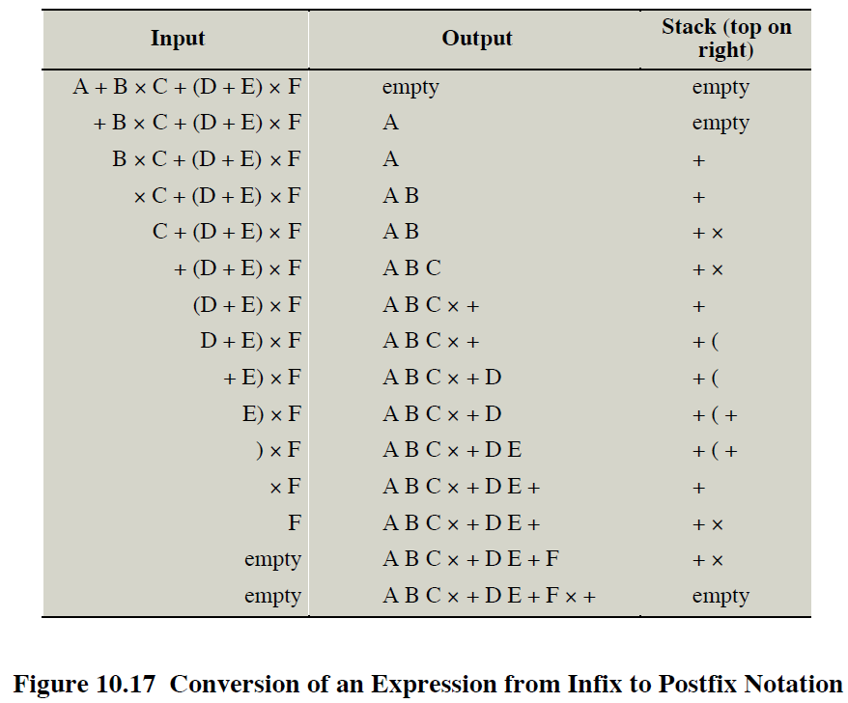
Infix to Postfix Notation

